Slide 1
Object Detection

Slide 2
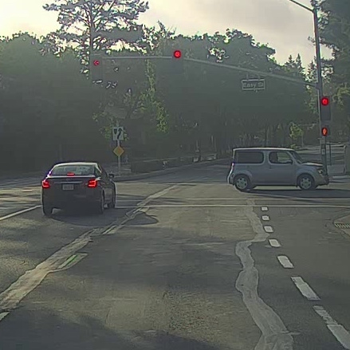
What are localization and detection?
Image classification
Classification with
localization
Detection

Slide 3
Car detection example
Training set:
x
y
1
1
1
0
0

Slide 4
Sliding windows detection

Slide 5
Sliding windows detection
Sliding window approach for detection is computationally intensive.

Slide 6
Object Detection
Convolutional implementation of sliding windows

Slide 7
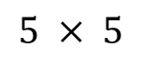
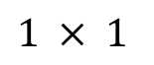
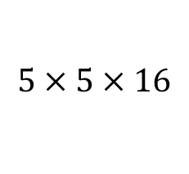
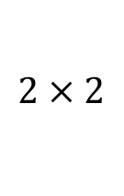
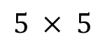
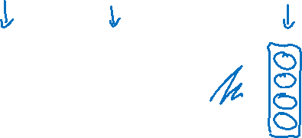
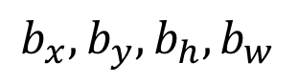
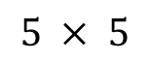
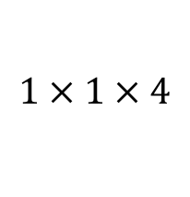
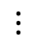
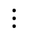
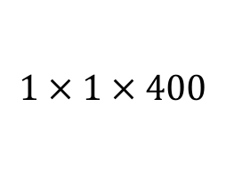
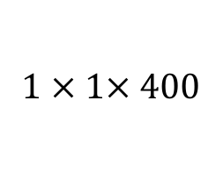
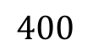

Turning FC layer into convolutional layers
MAX POOL
FC
FC
$$5 × 5$$
$$2 × 2$$
$$⋮$$
$$⋮$$
y
softmax (4)
$$14 × 14 × 3$$
$$10 × 10 × 16$$
$$5 × 5 × 16$$
$$400$$
$$400$$
MAX POOL
FC
FC
$$5 × 5$$
$$2 × 2$$
$$5 × 5$$
$$1 × 1$$
$$14 × 14 × 3$$
$$10 × 10 × 16$$
$$5 × 5 × 16$$
$$1 × 1× 400$$
$$1 × 1 × 400$$
$$1 × 1 × 4$$

Slide 8
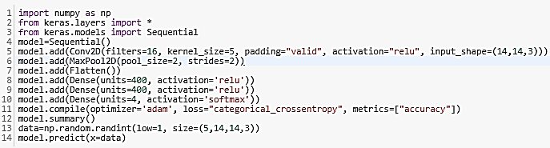
Turning FC layer into convolutional layers

Slide 9
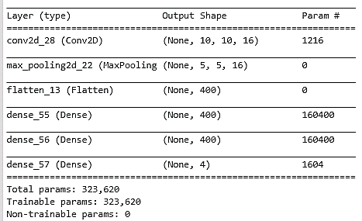
Turning FC layer into convolutional layers
Now, what if I change the size of x=data to 5 x 16 x 16 x 3 ?

Slide 10
Convolution implementation of sliding windows
Size of output volume = { [Size of input volume (16 x 16 or 28 x 28) – Size of Original Patch (14 x 14)]/2 + 1}

Slide 11
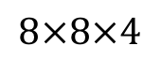
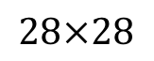
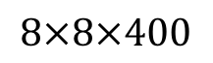
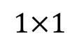
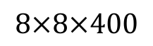
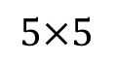
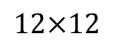
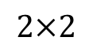
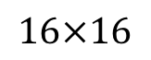
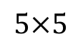
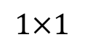
Convolution implementation of sliding windows
MAX POOL
$$5×5$$
$$2×2$$
$$5×5$$
$$1×1$$
$$1×1$$
$$28×28$$
$$16×16$$
$$12×12$$
$$8×8×400$$
$$8×8×400$$
$$8×8×4$$

Slide 12
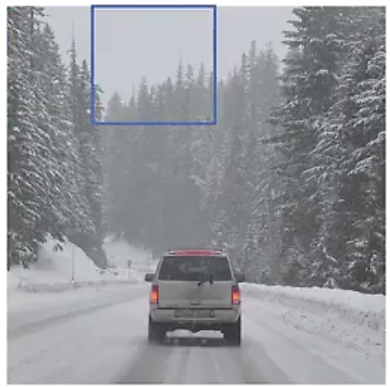
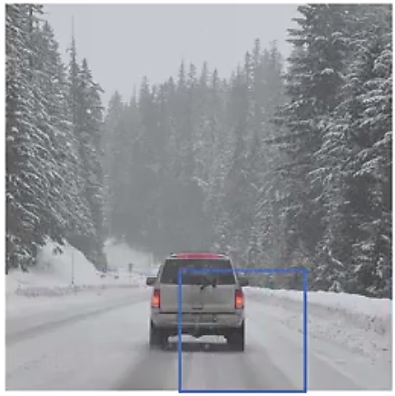
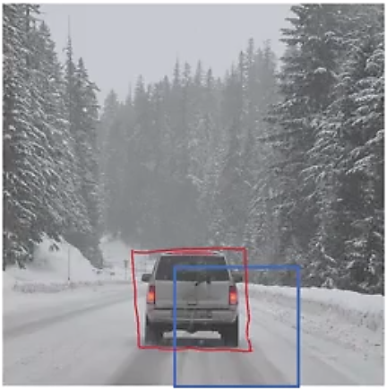
Output Accurate Bounding Boxes

Slide 13

Classification with localization (Regression Approach for Bounding Box)
$$⋯$$
$$⋮$$
1 - pedestrian
2 - car
3 - motorcycle
4 - background

Slide 14
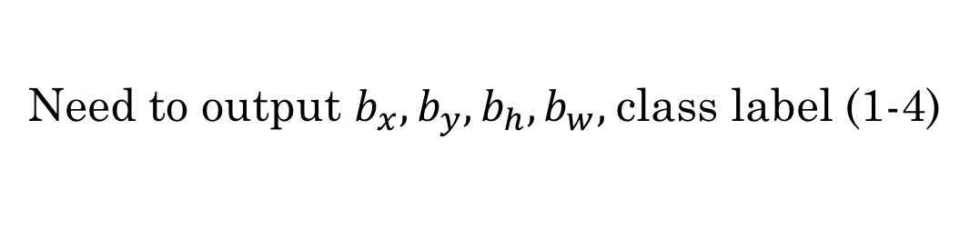
Defining the target label y
1 - pedestrian
Need to output $b_{x},b_{y},b_{h}, b_{w},$class label (1-4)
2 - car
3 - motorcycle
4 - background

Slide 15
References
https://github.com/rafaelpadilla/Object-Detection-Metrics
https://medium.com/@timothycarlen/understanding-the-map-evaluation-metric-for-object-detection-a07fe6962cf3
Andrew Ng’s slide on object detections

Slide 16
Disclaimer
These slides are not original and have been prepared from various sources for teaching purpose.

